Slide 1
Rebound in monocytes without increase in %BrdU+ monocytes after BLZ-945 in SIV+ART+ animals
Andrew Ding-Su

Slide 2
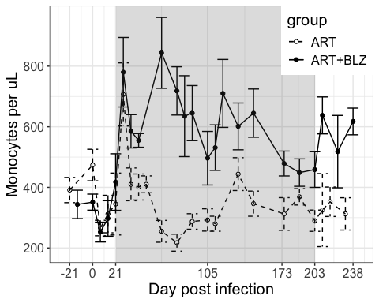
Monocyte numbers
BLZ

Slide 3
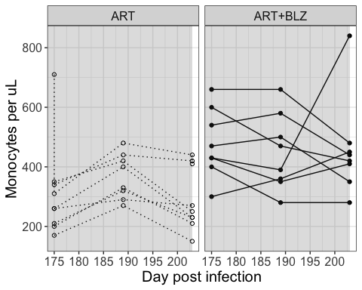
Total monocyte numbers remain the same during BLZ

Slide 4
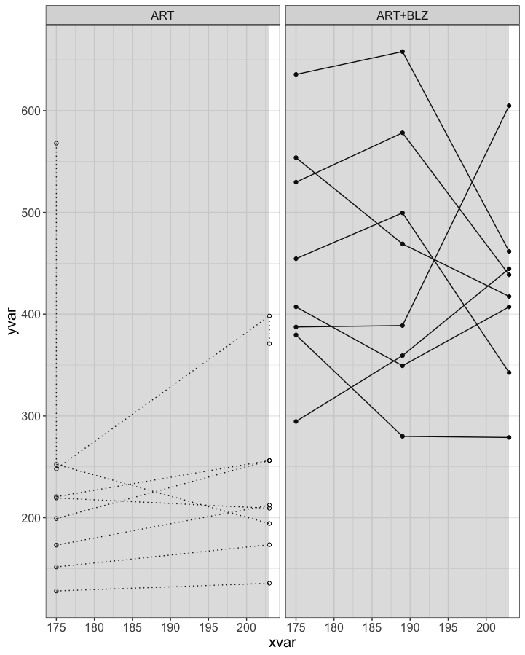
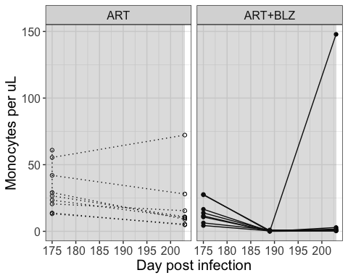
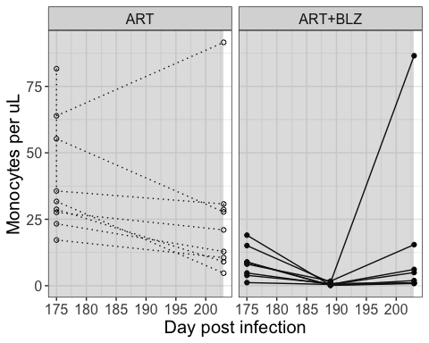
BLZ-945 may eliminate CD16+ monocyte populations (data not significant)
Classical
Intermediate
Nonclassical

Slide 5
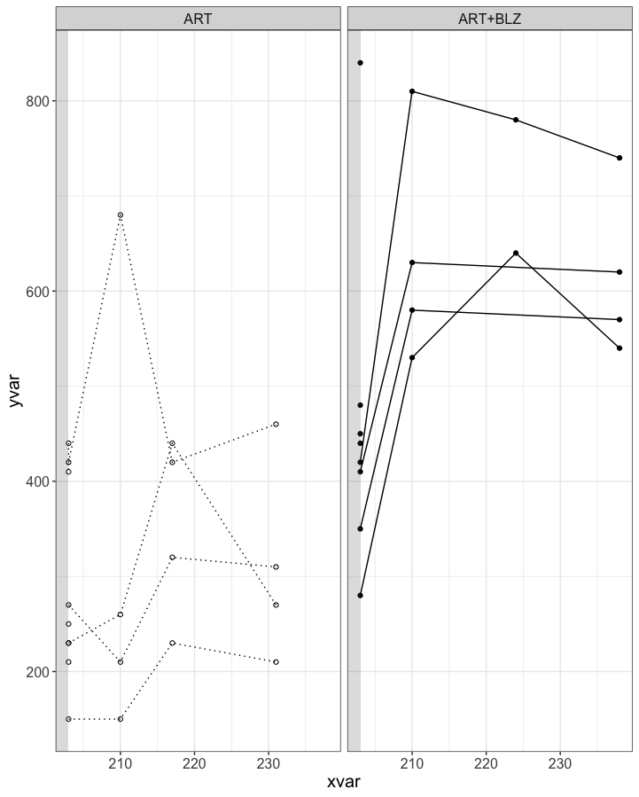
Trend of rebound in total monocytes in ART+BLZ animals (p=0.168), but not ART only animals

Slide 6
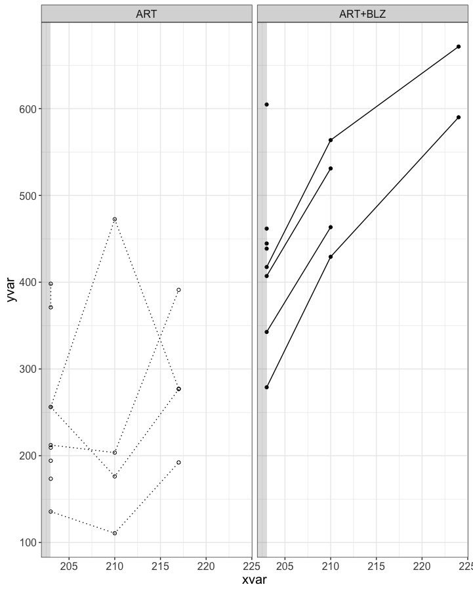
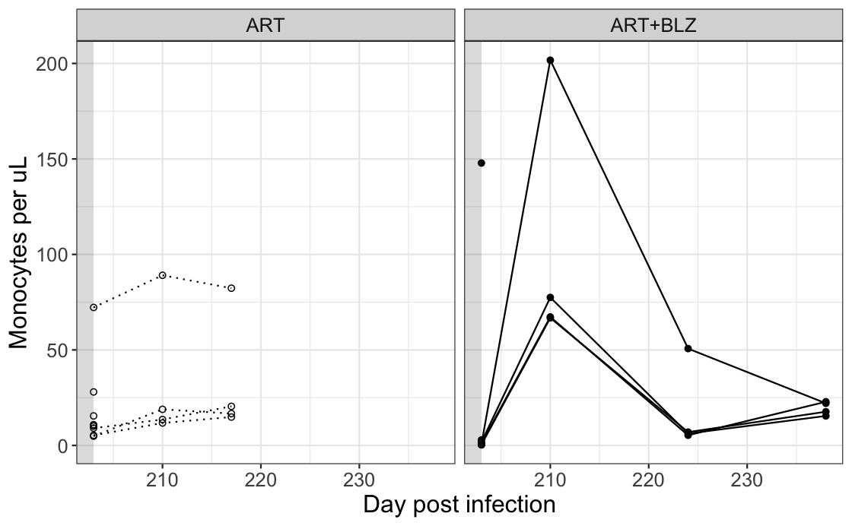
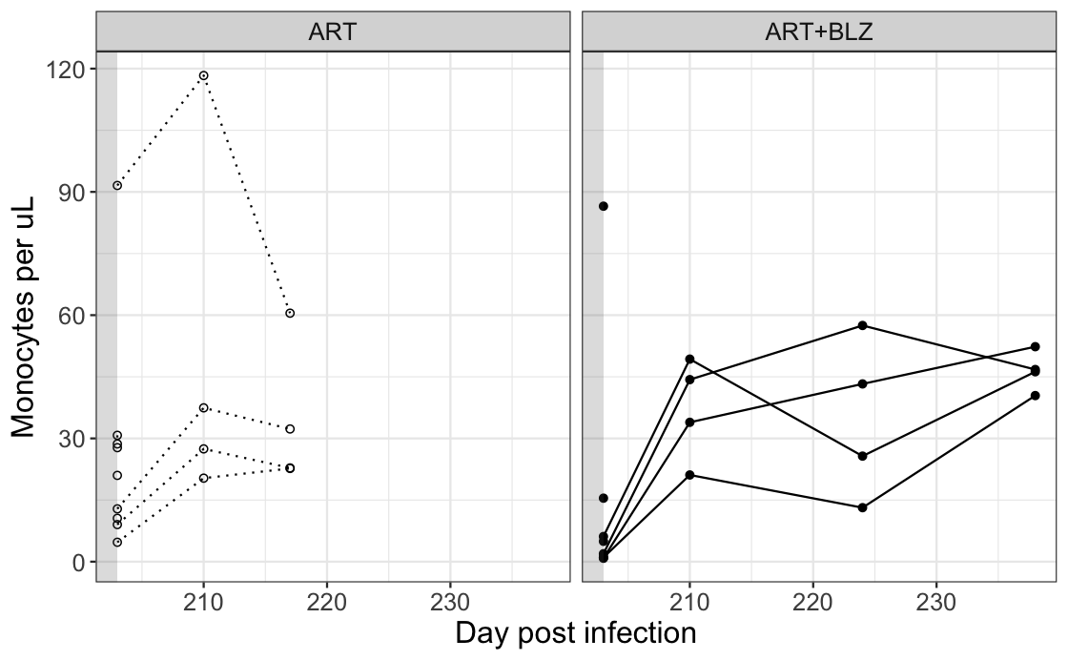
Sequential emergence of classical, intermediate, nonclassical monocytes in BLZ-945 treated animals?
classical
intermediate
nonclassical
p = 0.267
p = 0.0628
p = 0.002
p = 0.544
p = 0.485
p = 0.018

Slide 7
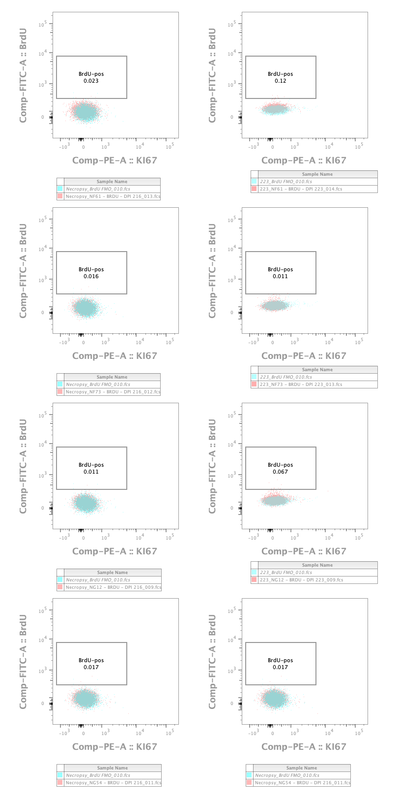
BLZ-945 animals have non-detectable %BrdU monocytes, despite rebound in monocyte numbers
1 day post BrdU
7 day post BrdU
Data from BLZ-945 treated animals, at dpi 217 (left column) and 223 (right column). BrdU was administered at 216 dpi.
No BrdU+ monocytes at any time after tx interruption in BLZ-945 treated animals.

Slide 8
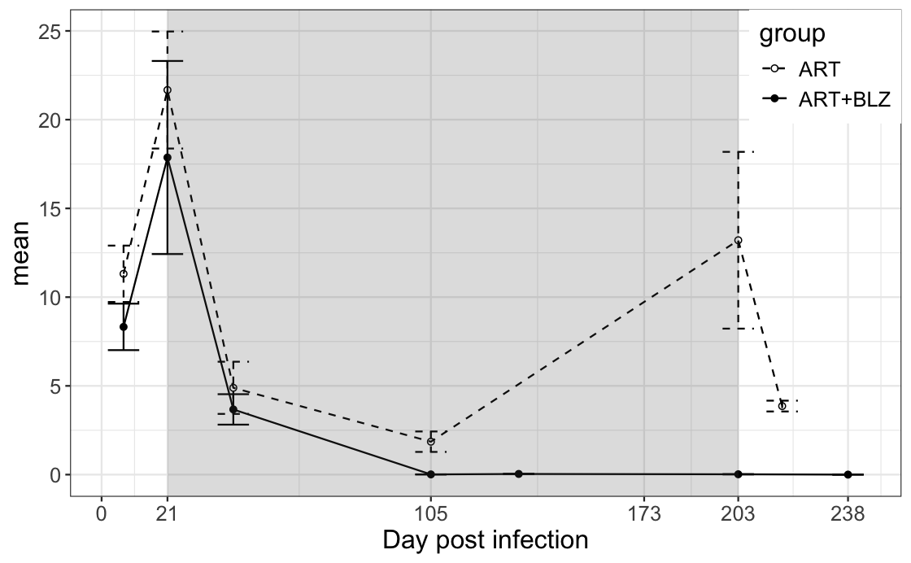
BLZ-945 animals have non-detectable %BrdU monocytes, despite rebound in monocyte numbers
BLZ

